Slide 1
Tolerance-Based
Time-Current Coordination

Slide 2
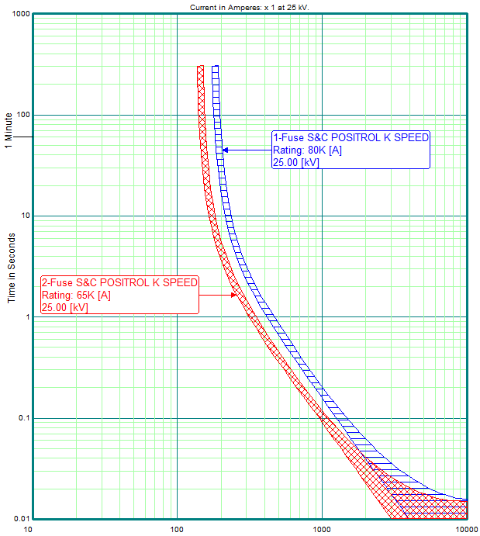
Fuse coordination uses min & max TCC responses, ensuring curves don’t touch for an appropriate level of current
So why not use this method when coordinating relays?

Slide 3
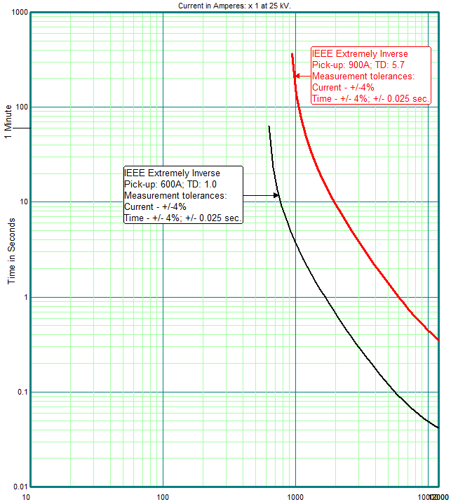
Conventional coordination uses single, nominal TCC lines
CTI
0.3 Sec.
TCC lines are separated by a Coordinating Time Interval (CTI)
12,000

Slide 4
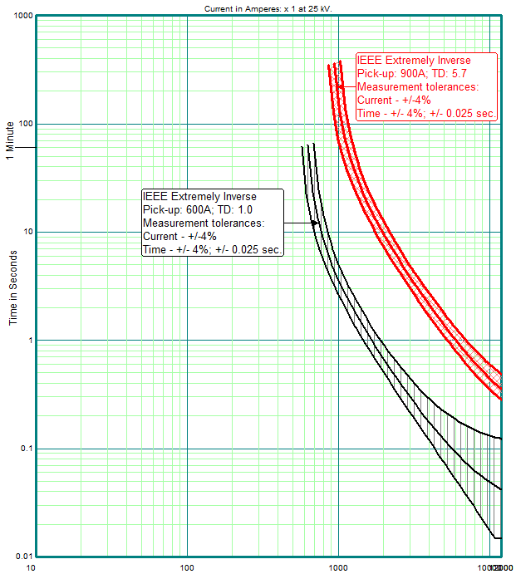
Current & time tolerances are applied to single, nominal TCCs
C class or 10P20 CT modeled as +/-5% measurement error
CTI
0.3 Sec.
Interrupter fault-clear = 0.05 sec. (3~ at 60 Hz)
12,000

Slide 5
Resulting time-interval between max & min TCC responses
0.16 Sec.
12,000

Slide 6
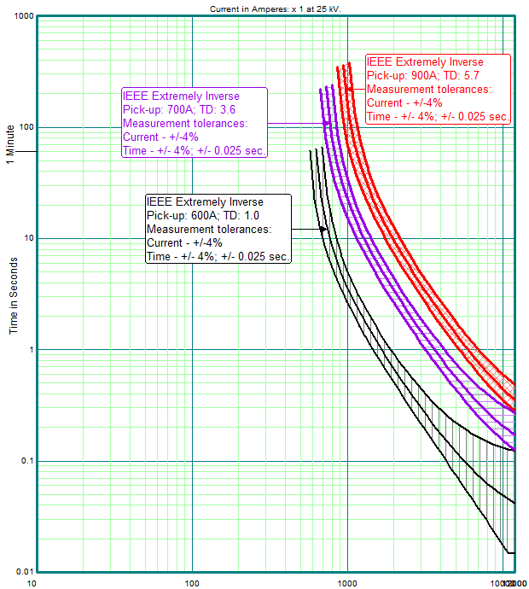
Due to “CTI-slop” we can squeeze in one more device!
CTI
0.3 Sec.
12,000

Slide 7
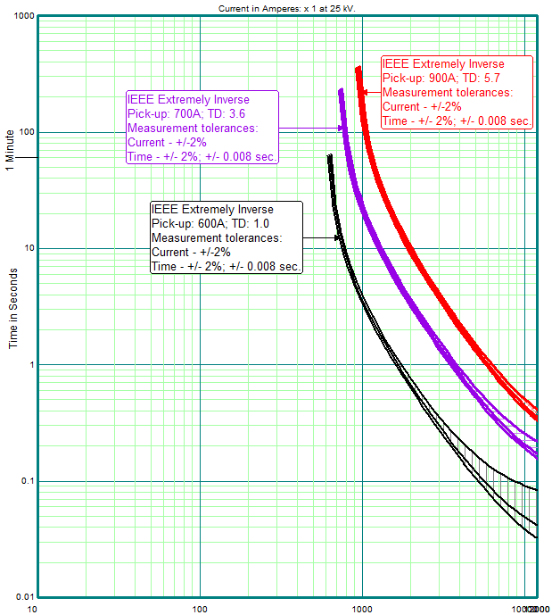
Current & time responses modeled as +/-2% tolerance
Current response-tolerances include primary-current sensing-device error
CTI
0.3 Sec.
Interrupter fault-clear = 0.033 sec. (2~ at 60 Hz)
12,000

Slide 8
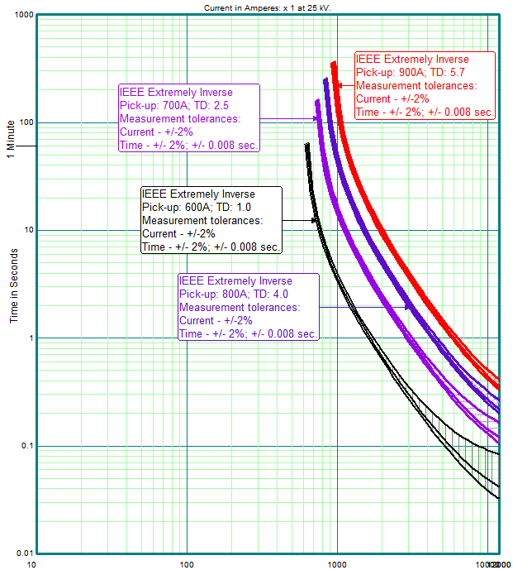
Tighter tolerances = More series fault-interrupters
CTI
0.3 Sec.
12,000

Slide 9
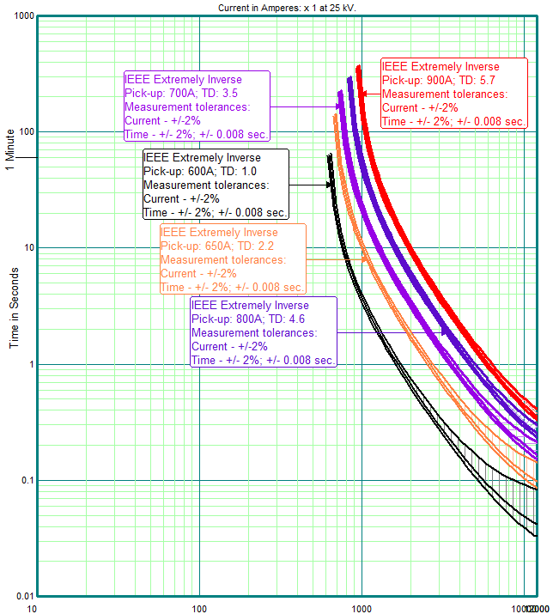
Tolerances are so tight, we can insert yet another device!!
CTI
0.3 Sec.
12,000

Slide 10
We used TCC tolerance-response bands and coordinated more series devices within the same CTI time-value
We used the CTI method and coordinated 2-devices
CTI / 2-devices
Good Tolerances / 3-Devices
Better Tolerances / 5-Devices
CTI
0.3 Sec.
(CTI coordinated 2-devices)
12,000
12,000
12,000

Slide 11
Whether to use +/-5% or +0/-10% CT error (C class or 10P20)
Nominal TCC
+0% CT error
+5% CT error
-10% CT error
-5% CT error
Note: Both TCC bands have the same time and (other) current tolerances (+/-).
C class or 10P20 CTs shall (essentially) not produce more than 10% error from 1-20X rated current.
Nominal TCC

Slide 12
+/-5% CT error results in more conservative coordination
Nominal TCC
+0% CT error
+5% CT error
-10% CT error
-5% CT error
Nominal TCC

