Slide 1
Development and Implementation of Composite Load Model in WECC
2015 CIGRE
Grid Of The Future Conference
Presented by
Dmitry Kosterev, BPA

Slide 2
History Of Load Modeling
1980’s – Constant current real, constant impedance reactive models connected to a transmission bus
Reflected the limitation of computing technologies of that time
1990’s – EPRI Loadsyn effort
Several utilities use static polynomial characteristics for load representation
1990’s – IEEE Task Force recommends dynamic load modeling
The recommendation does not get much traction in the industry

Slide 3
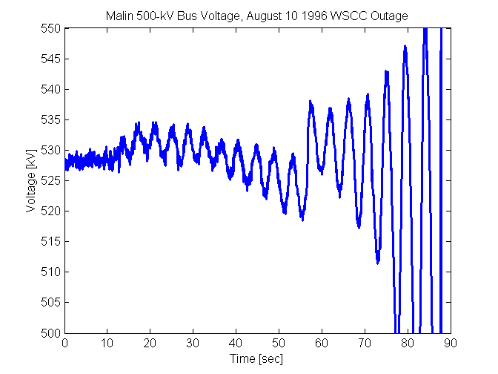
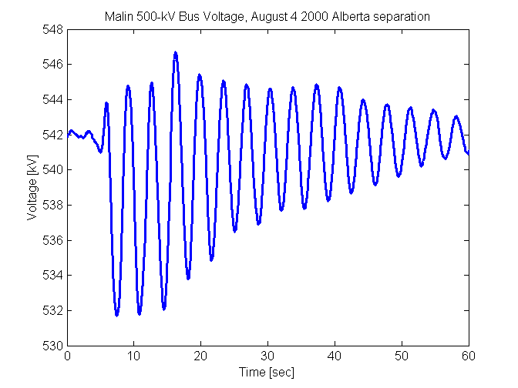
1996 Large-Scale Outages in the West
July 2, 1996
August 10, 1996
August 4, 2000

Slide 4
2001 “Interim” Load Model
2001 – WECC “Interim” Load Model:
  20% of load is represented with induction motors, the remaining load is static, mainly constant current active, constant impedance reactive components
  Motors were connected at high voltage bus, data representative of large fan motors (source John Undrill)
  Same percentage was applied to all areas in WECC
  Was the only practical option available in 2001
  “Interim” load model was intended as a temporary solution to address oscillation issues observed at California – Oregon Intertie
  Was in use until 2014 when superseded with composite load model

Slide 5
Events of Delayed Voltage Recovery in Southern California
1980’s – Southern California Edison observed events of delayed voltage recovery attributed to stalling of residential air-conditioners
  Tested residential air-conditioners, developed empirical AC models
1997 – SCE model validation study of Lugo event.
2004-06 FIDVR events in Valley area

Slide 6
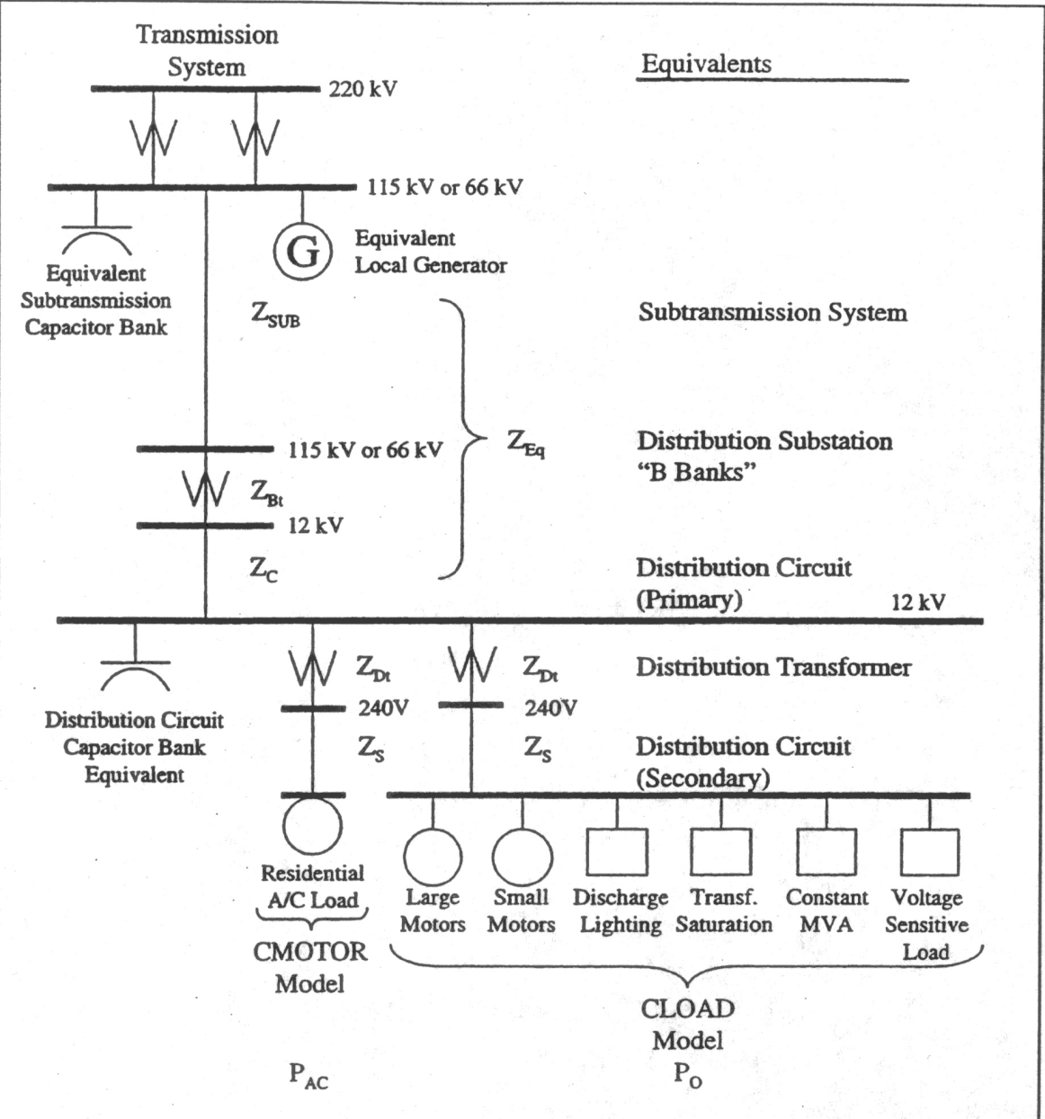
Southern California Edison
Need to represent a distribution equivalent
Need to capture diversity of end-uses
Need to have special models for air-conditioning load

Slide 7
Early Load Modeling Efforts in the East
1994 – Florida Power published an IEEE paper, used a similar load model
1998 – Events of delayed voltage recovery were observed in Atlanta area by Southern Company, the events are analyzed and modeled
Southern Company and Florida Power used approaches similar to SCE’s.
The approach was later adopted by WECC in the development of the composite load model…

Slide 8
WECC Load Modeling Task Force
2005 – WECC developed “explicit” load model:
  Adding distribution equivalent to powerflow case WECC-wide
  Modeling load with induction motors and static loads
  Numerically stable in WECC-wide studies !
2007 – PSLF has the first version of the composite load model (three-phase motor models only)
2006-2009 – SCE-BPA-EPRI testing residential air-conditioners and developing models
2009 – residential air-conditioner model is added to the composite load model

Slide 9
Implementation Plan for Composite Load Model
Model Structure
Model structure must be implemented in production programs, validated and must be robust and numerically stable in large scale simulations
B. Data
Tools for data management are available
Processes for providing data are established
Default data sets are available
C. Studies
Model validation studies
System impact and sensitivity studies

Slide 10
Composite Load Model Structure

Slide 11
Composite Load Model Structure
M
12.5-kV
13.8-kV
M
69-kV
115-kV
138-kV
M
AC
UVLS
UFLS
Electronic
GE PSLF
Siemens PTI PSS®E
Power World
Static

Slide 12
“Performance Model” for Air-Conditioners
Motors stall when voltage drops below Vstall for duration Tstall
A fraction Frst of the aggregated motor can restart when the voltage exceeds Vrst for duration Trst
Motor thermal protection is modeled

Slide 13
Data

Slide 14
Load Model Data
Load Component
Model
Data
Distribution Equivalent Data
M
M
69-kV
115-kV
138-kV
M
Load Model
Composition
Data
M
UVLS and UFLS Data
Electronic
Static

Slide 15
Load Model Data
Develop understanding of electrical end uses in various buildings, do not rely solely on consultants with elaborate building models
  Building models can help develop understanding, but should not be used as the primary source
When you walk in Whole Foods on hot summer day, do you know how much load is refrigeration / AC / lighting / fans / cooking? Do you know expected size and type of compressor motors? Do you know what building EMS system will possibly do during a fault?
We need to develop this expertise

Slide 16
Summer peak demand in California
Residential AC
Lighting
Ventilation
LBNL
Commercial AC
Refrigeration

Slide 17
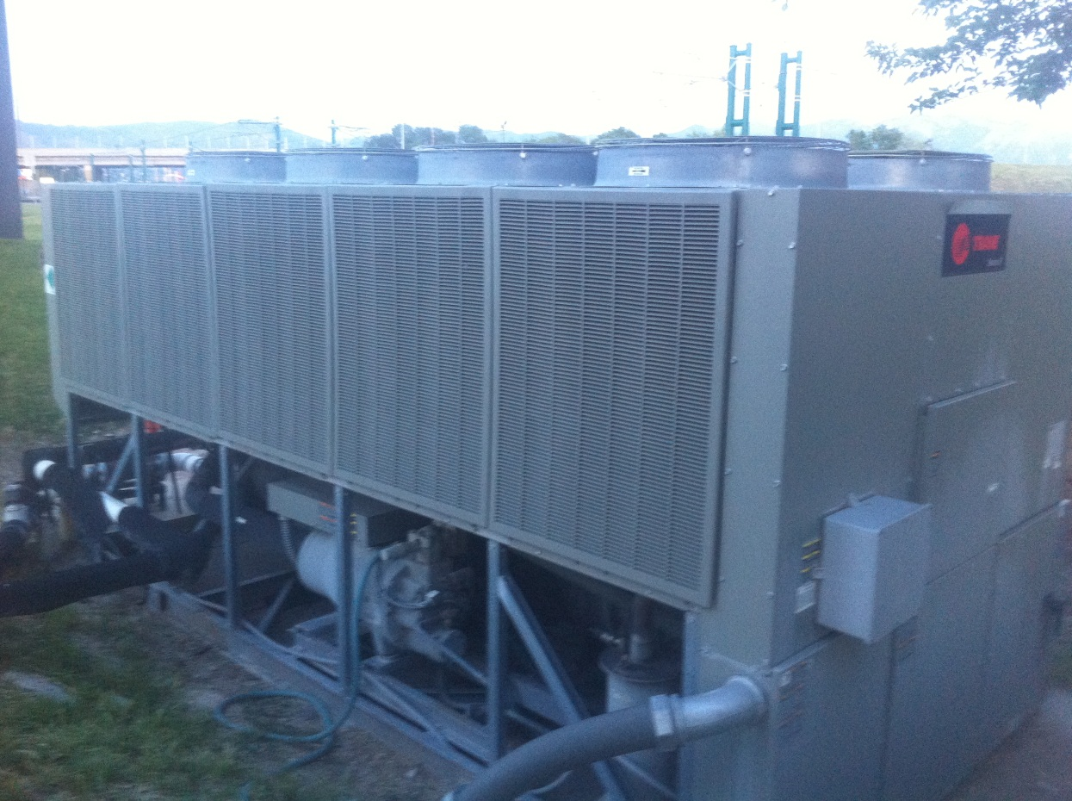
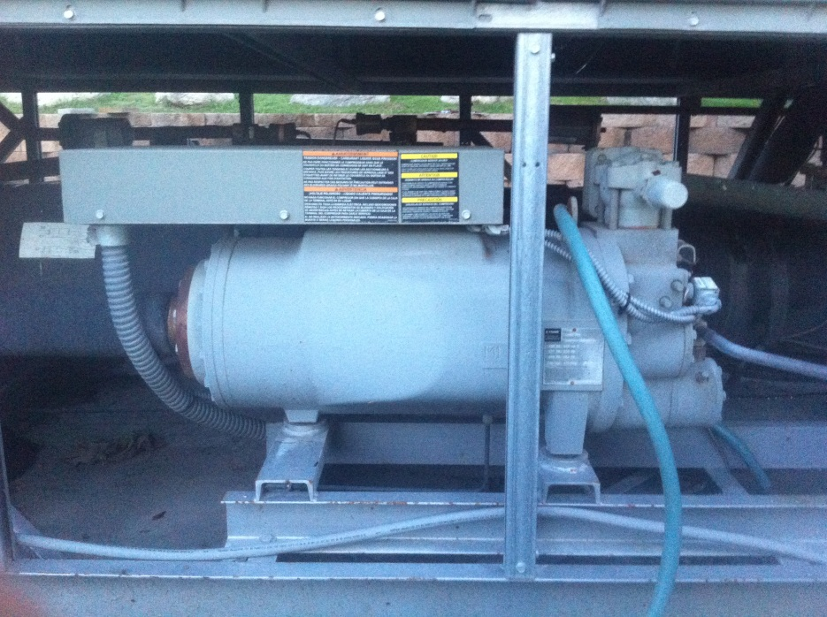
Heat Exchanger Fans
Hotel in Salt Lake City
125 rooms
Compressor
2 Compressor Motors:
A: 3-ph, 460 V, 139 RLA, ~94kW / 70 hp
B: 3-ph, 460 V, 118 RLA, ~80kW / 60 hp
9 Fan Motors:
3-ph, 460V, 1.25 hp each
Compressor

Slide 18
CEC California Commercial End-Use Survey
Summer Peak Load
Cooling
Lighting
Ventilation
Refrigeration

Slide 19
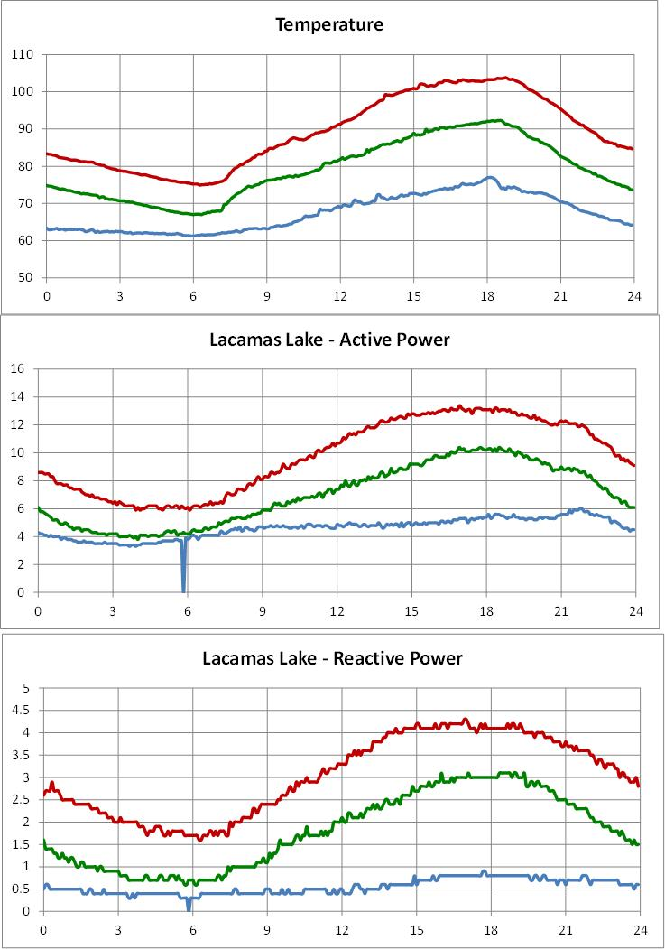
Residential
Commercial

Slide 20
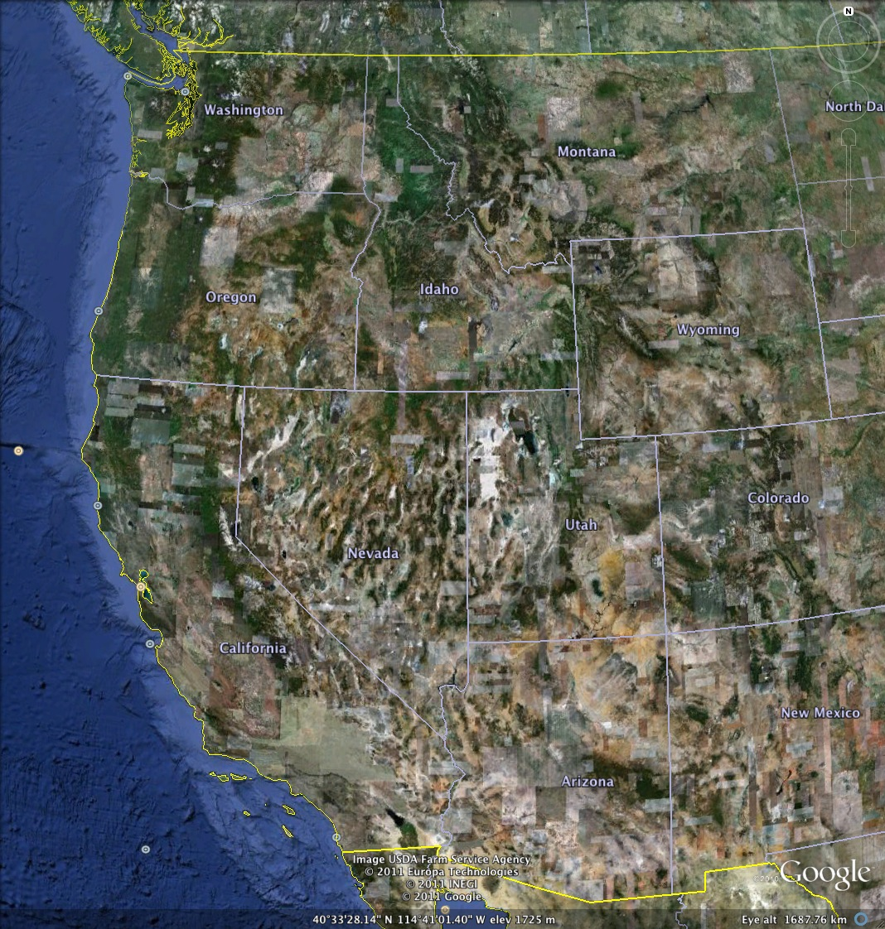
Climate Zones
NWC – Northwest coast
NWV – Northwest valley
NWI – Northwest inland
RMN – Rocky mountain
NCC – N. Calif. coast
NCV – N. Calif. Valley
NCI – N. Calif. Inland
HID – High desert
SCC – S. Calif. coast
SCV – S. Calif. Valley
SCI – S. Calif. Inland
DSW – Desert southwest
NWC`
NWI
RMN
NWV
NCC
HID
NCV
SCC
SCV
DSW

Slide 21
Studies

Slide 22
Model Acceptance and Validation Studies
Tens of thousands runs have been done with composite load model up to date
Validate model impact on power system performance:
Large interconnection-wide disturbances
Faults that include FIDVR
Challenges:
Load composition varies daily and seasonally
Lack of disturbance recordings, particularly FIDVR records outside Valley area in Southern California

Slide 23
August 4, 2000 Oscillation
WECC Interim Model
CMPLDW with default data
CMPLDW with “tuned” data

Slide 24
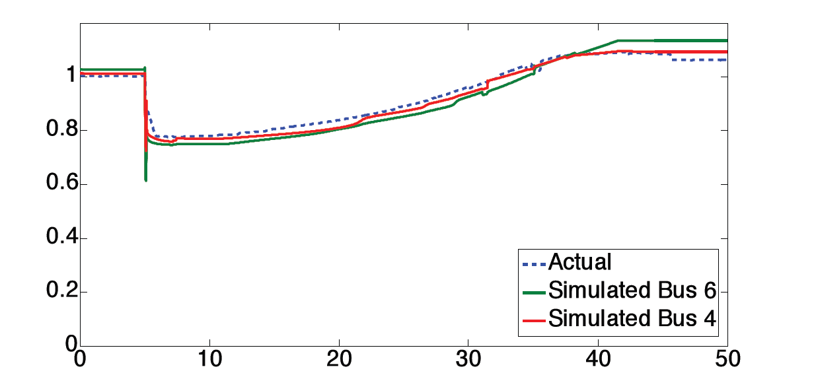
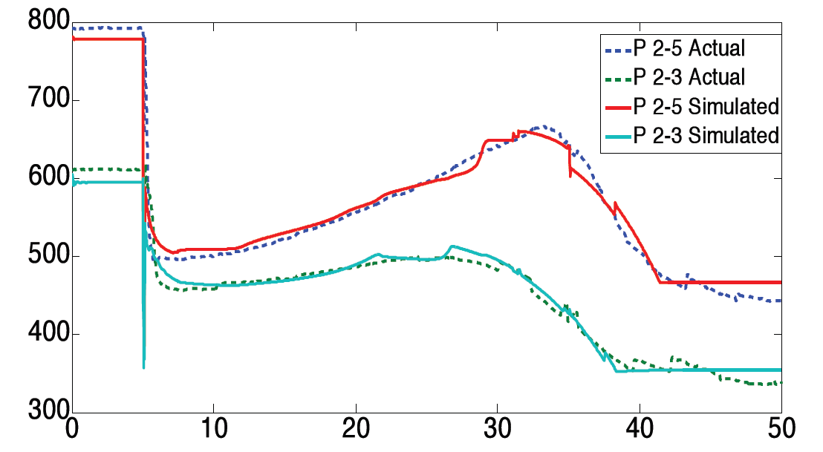
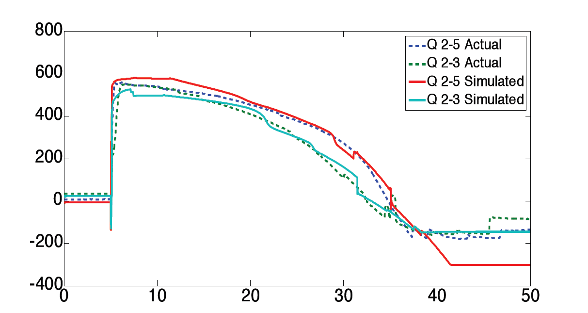
Reproducing Delayed Voltage Recovery Events with Composite Load Model
Simulations of delayed voltage recovery event due to air-conditioner stalling
Models can be tuned to reproduce historic events reasonably well
Done by Alex Borden and Bernard Lesieutre at University of Wisonsin

Slide 25
July 28, 2003
Hassayampa Fault Sensitivities

Slide 26
System Impact Studies
We were able to tune the composite load model to reproduce historic system events
That said…
Composite load model was more conservative in simulating the severity of FIDVR events than we expected
Another concern is high sensitivity of results with respect to stall and motor protection assumptions
Therefore,
WECC adopted phased implementation of composite load model: Phase I – air-conditioner stalling feature is disabled

Slide 27
Implementation

Slide 28
Phased Implementation in the West
2011 WECC approved phased implementation plan:
  Model indicated AC stalling much greater than what experienced in reality outside Valley area in Southern California
  Lack of validation outside Valley area
  WECC voltage dip criteria
  More gradual transition
Phase I – air-conditioner stalling feature is disabled
WECC membership performed system impact studies
Model data revisions were implemented
WECC approved composite load model in 2013
Starting 2014, all WECC planning and seasonal operating cases include Phase I composite load model

Slide 29
Lesson’s Learned from Phase I Implementation
Phase I model impacted system performance:
Damping of inter-area power oscillations
Transient voltage dip
The impact is observable during large disturbances and close to the operating limit, the impact is less significant during small events
Several utilities voiced concerns about load tripping
Notes:
Events

Slide 30
Where we are now …
Composite load model is implemented in GE PSLF and Siemens PTI PSS®E, similar models exist in Power World, Power Tech TSAT
Tools are developed for load model data management
“Default” data sets are prepared
WECC is taking phased approach for approving the composite load model for TPL compliance studies
  Phase 1: air-conditioner stalling is disabled by setting Tstall parameter to a large number
  Phase 2: better understand the reliability implications of delayed voltage recovery due to air-conditioner stalling, develop appropriate reliability metrics

Slide 31
… Where we are now
All planning and seasonal operational cases prepared by WECC now have composite load model
Tens of thousands runs have been done with the composite load model up to date
WECC studies help to improve model data sets

Slide 32
Next Steps

Slide 33
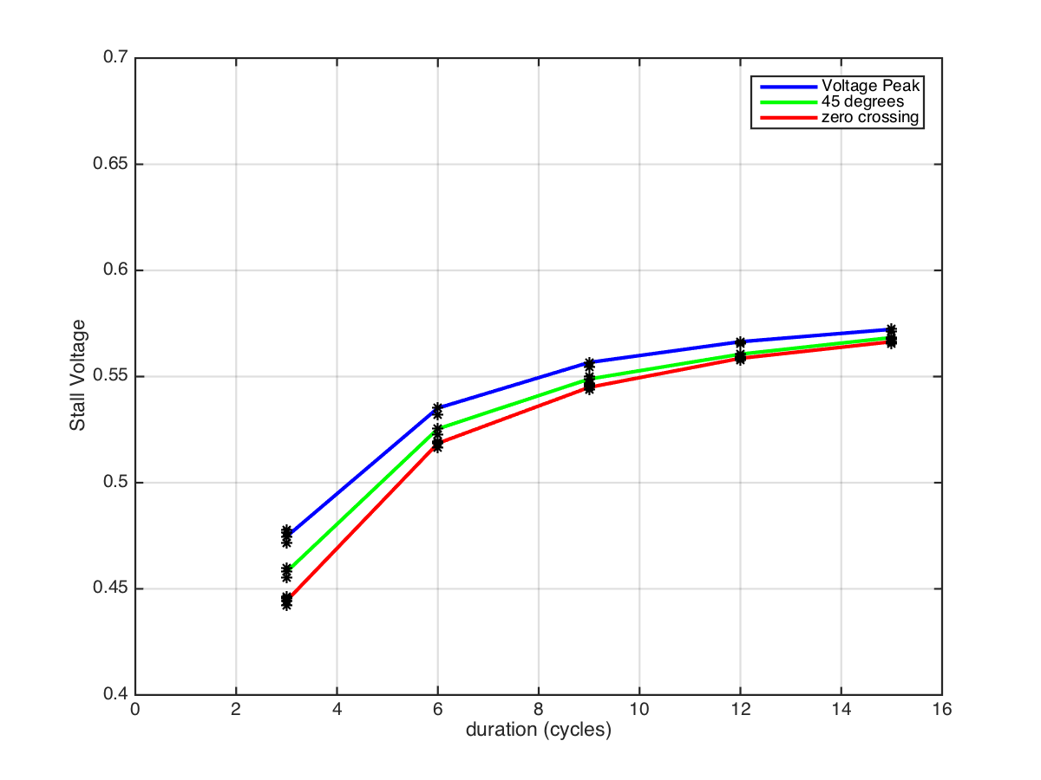
AC Model Revisions
New work by John Undrill, Bernie Lesieutre and BPA suggests that air-conditioners may not stall as easy as previously expected
Current AC Stall threshold
Proposed AC Stall threshold

Slide 34
Planned Revisions to Model Structure
Flexible model structure
Electrical end-use characteristics are changing rapidly, as more loads become electronically connected
Modular structure (similarly to generating units)
Air-conditioner models
Revise “performance” model to reflect recent test findings
Add MOTORC dynamic model
Distributed generation
Revision of motor protection
From discrete to more granular

Slide 35
Model Data
Composite load model is a very powerful.
Deepen our understanding of end-uses.
Building surveys
Installed equipment
Load shapes
Protection and control
End-use monitoring
Load shape analysis

Slide 36
Disturbance Monitoring
We need more recording of both FIDVR events as well as large faults not causing FIDVR
  Synchronized recordings at transmission and distribution levels
System impact studies for Phase II and sensitivity studies with respect to model parameters
    Continue after model improvements are completed
Notes:
Events

Slide 37
Load Modeling – Setting Expectations
We can now achieve the great accuracy with generator models:
  We model physical equipment that is well defined and under our control
We will never be able to achieve a comparable level of accuracy with load models
  Yes, we can tune load models to accurately reproduce and explain past events
  But, Load models is only capable of predicting the future load response only in principle, and not in detail

Slide 38
Additional Resources
2015 DOE-NERC FIDVR Workshop in Alexandria, VA
NERC
http://www.nerc.com/comm/PC/System%20Analysis%20and%20Modeling%20Subcommittee%20SAMS%20201/Workshop%20Presentations%20Fault-Induced%20Delayed%20Voltage%20Recovery%20(FIDVR).pdf
CETRS
https://certs.lbl.gov/project/fidvr-meetings-and-workshops

Slide 39
Thank You
D.KOSTEREV¹, J.WEN², R.BRAVO², S.LU³, S.YANG¹, H.HINDI¹, S.WANG⁴, J.UNDRILL, W.PRICE, J.KUECK, B.LESIEUTRE⁵,
D.DAVIES⁶, D.CHASSIN⁷, J.ETO⁸
¹Bonneville Power Administration, USA
²Southern California Edison, USA
³Seattle City Light, USA
⁴Pacificorp, USA
⁵University of Wisconsin-Madison, USA
⁶Western Electricity Coordinating Council, USA
⁷Pacific Northwest National Laboratory, USA
⁸Lawrence Berkeley National Laboratory, USA

