Slide 1
Adoption of Smart Grid Technologies: Results of a Survey of U.S. Electric Utilities
Jason Dedrick, You Zheng
School of Information Studies, Syracuse University
Presented at the 2015 Grid of the Future Symposium
October 11-13, Chicago, IL
This material is based upon work supported by the National Science Foundation under Grant No. SES-1231192. Any opinions, findings, and conclusions or recommendations expressed in this material are those of the authors and do not necessarily reflect the views of the National Science Foundation.

Slide 2
Research questions
1. What is the level of deployment of different smart grid technologies among U.S. electric utilities?
2. What are the main motivations for smart grid deployment?
3. What are the main obstacles to deployment?
4. What are the main organizational impacts of smart grid adoption?
5. How do IOUs, municipals and cooperatives differ in terms of adoption rate, motivations and organizational factors?

Slide 3
Research methods
Survey of 217 representatives of 198 U.S. electric utilities
38 IOUs, 64 municipals, 96 cooperatives
31 didn’t answer any questions, so 186 usable surveys.
Not all answered all questions, so N varies by question.

Slide 4
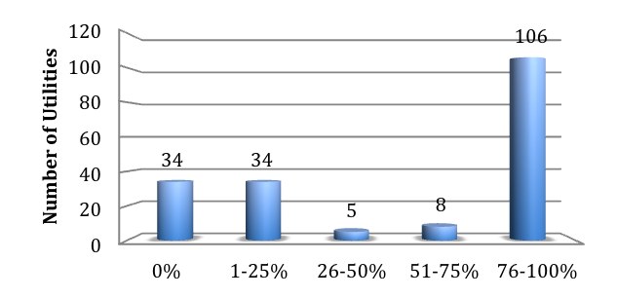
Level of deployment: AMI

Slide 5
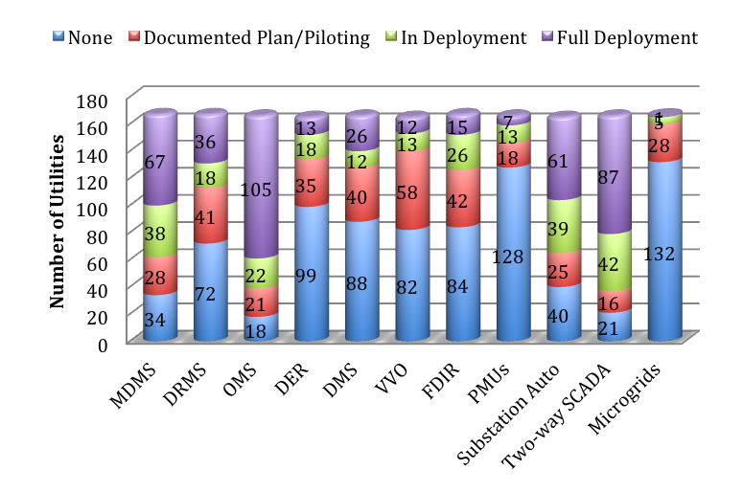
Level of deployment: grid-side technologies

Slide 6
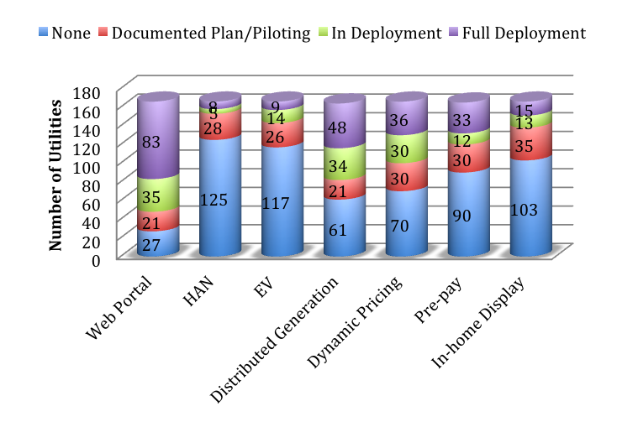
Level of deployment: customer – side technologies
Notes:
Utilities do very little R&D. Just 0.3% of revenues. Don’t develop technologies but need to test them before deploying in their environment.
Business processes. For instance, outage management and customer service were separate, but smart meter data can be used to isolate and fix problems and to actively notify customers of repair status.
Big Data has great potential, but requires skills and infrastructure for management and analysis
Project management. One interviewee has 63 projects underway. Many of these are contingent on others and need overarching PM.

Slide 7
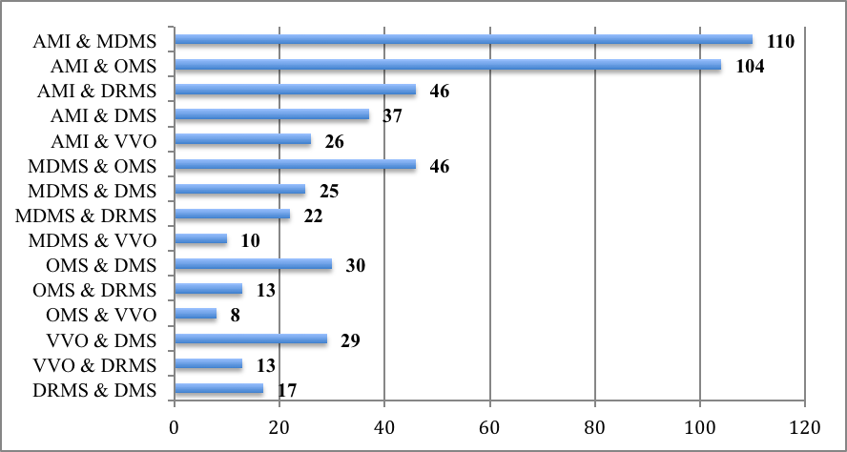
Integration of smart grid technologies

Slide 8
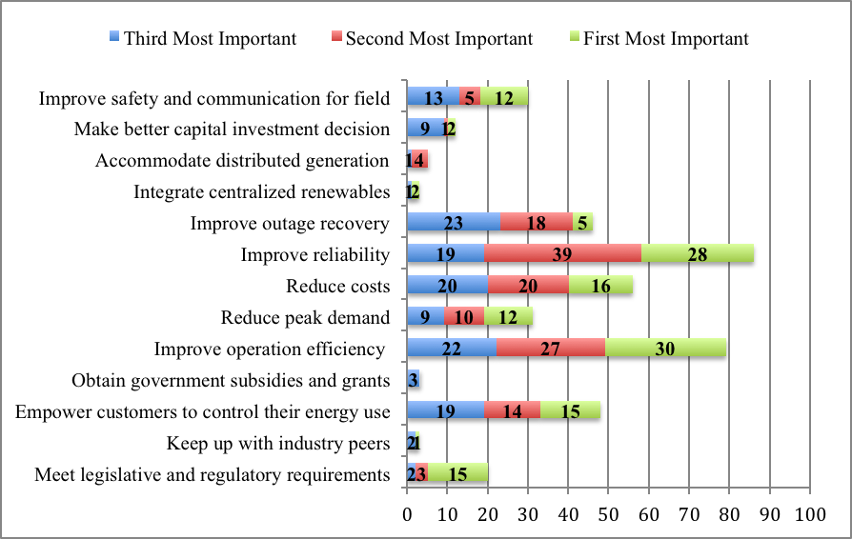
Motivations to adopt smart grid

Slide 9
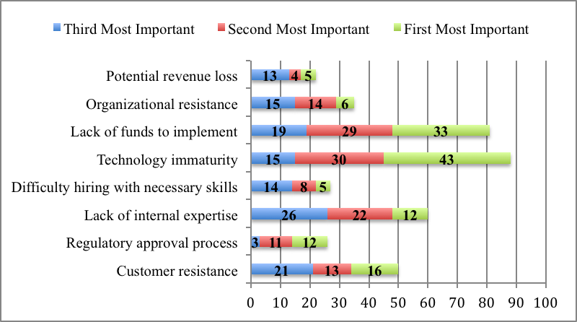
Obstacles to smart grid adoption

Slide 10
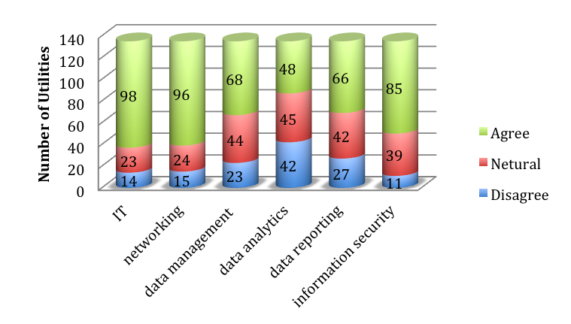
We have a high level of expertise:

Slide 11
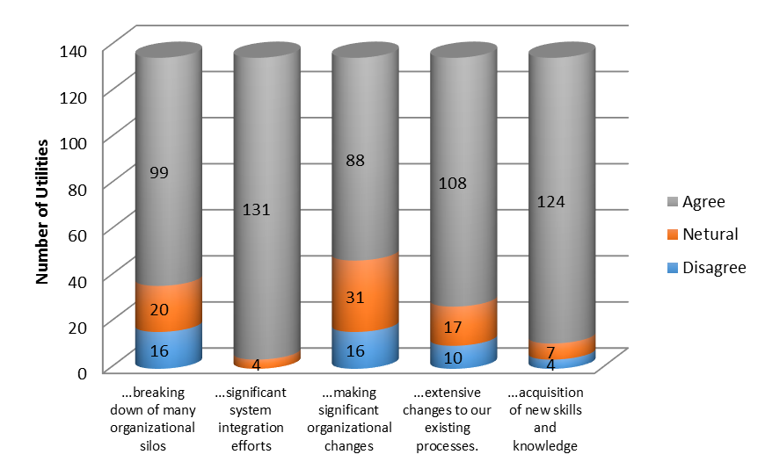
Organizational impacts

Slide 12
IOUs, municipals and co-ops
No difference in AMI deployment
IOUs have significantly higher deployment of grid technologies, e.g., MDMS, OMS, DER, DMS, VVO, PMU and microgrids.
IOUs have higher deployment of HAN, EV, dynamic pricing and in-home displays. Co-ops have higher use of pre-paid pricing.
No significant differences in motivations, obstacles, expertise or organizational impacts.

Slide 13
Other factors influencing adoption
Initial regression results on adoption of grid-side technologies.
  Ownership
  Expertise
  Organizational monitoring and responsiveness to technology changes
  Inconclusive on attitudes of regulators or board members.

Slide 14
Conclusions
Smart grid adoption varies widely across utilities and across technologies.
Main motivations are cost savings and operational improvement. Main obstacles are technology maturity and cost.
Regulatory/policy factors somewhat less important than expected.
Adoption requires significant change in organizational structure and processes.

Slide 15
Smart grid research projects at Syracuse
1. Smart grid adoption by U.S. utilities
2. Data privacy and smart meters
3. Big Data analysis of consumer electricity use
smartgridresearch.syr.edu
jdedrick@syr.edu

