Slide 1
Increased Reliability of EHV Systems through Station Switchable Spare Transformer and Shunt Reactor Design and Operation
C.L. BELKNAP, C.E. JONES, P.E., O.A. MILLER, P.E., R.A. OBERSTER, K.R. POSEY, P.E.
American Electric Power
United States of America
Notes:
Olivia
Welcome & introduction of Chris and myself. Read title…

Slide 2
Introduction
An innovative new concept for the design and operation of EHV transformers and shunt reactor banks was developed and implemented within AEP’s 765kV substations.
This improvement provides our utility the ability to restore 765kV bus and circuits in the event of a failure of a transformer or shunt reactor in a fraction of the time previously spent.
Notes:
Olivia
< read slide >
Chris will be speaking about the physical layout progression of our switchable spare design.
< transition to Chris >

Slide 3
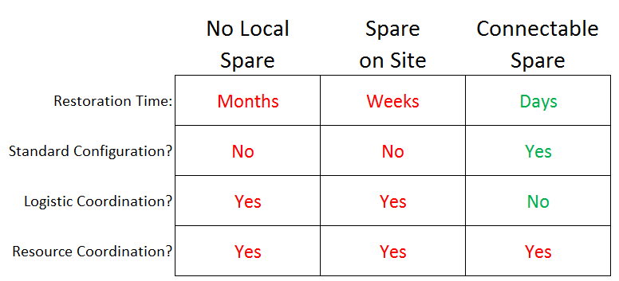
Old Standard Physical Layout Types
Notes:
Chris
Historically, AEP relied upon having a very solid sparing strategy for critical transmission assets. This assured availability of equipment across the system in the event of extended maintenance or failure. Two of the most expensive and logistically challenging pieces of substation equipment are 765kV transformers and shunt reactors.
While this sparing strategy assured that equipment was available when needed, there was still considerable time and effort required to restore service following the failure of a 765kV transformer or shunt reactor. Coordination across multiple departments (Transmission Field Services, Transmission Station Engineering, Transmission Planning, and Transmission Operations) was required. Restoration time ranges from multiple days if the station design included a spare (requiring modification to the existing bus), to months if the replacement must be shipped from another substation. The latter circumstance left the 765kV system vulnerable and requiring additional measures by Transmission Operations to ensure system reliability and stability are maintained.

Slide 4
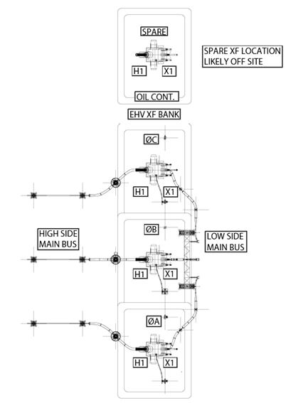
Old Standard Physical Layout
Notes:
Chris
While this sparing strategy assured that equipment was available when needed, there was still considerable time and effort required to restore service following the failure of a 765kV transformer or shunt reactor. Coordination across multiple departments (Transmission Field Services, Transmission Station Engineering, Transmission Planning, and Transmission Operations) was required. Restoration time ranges from multiple days if the station design included a spare (requiring modification to the existing bus), to months if the replacement must be shipped from another substation. The latter circumstance left the 765kV system vulnerable and requiring additional measures by Transmission Operations to ensure system reliability and stability are maintained.
This slide shows our older standard layout, with the spare electrically separated from the other banks, and often physically as well. When this spare would be put into service, the high side and low side bus would need to be reconfigured to connect to the spare, during the failed outage.

Slide 5
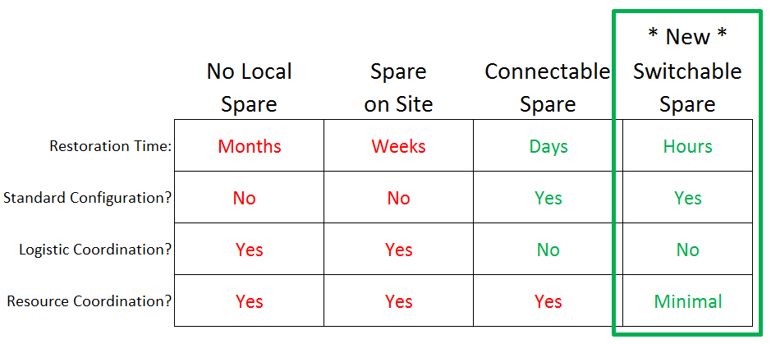
New Standard Physical Layout
A Switching Operation
Notes:
Chris
Seeking a quicker way to switch a transformer online, AEP found a more efficient layout to reduce outage time. The new layout involved the spare unit being installed directly next to the other units and be permanently connected through switchable systems that enable only a short outage to perform the switching operations.
This chart shows how the new design and layout is better than our historical layouts and methods. Outage time is reduced to a matter of hours. We maintain a standard configuration. Logistical transporting and constructing bus to the spare is eliminated. And, coordinating resources between multiple departments to switch in the spare and restore service to the grid is minimized.

Slide 6
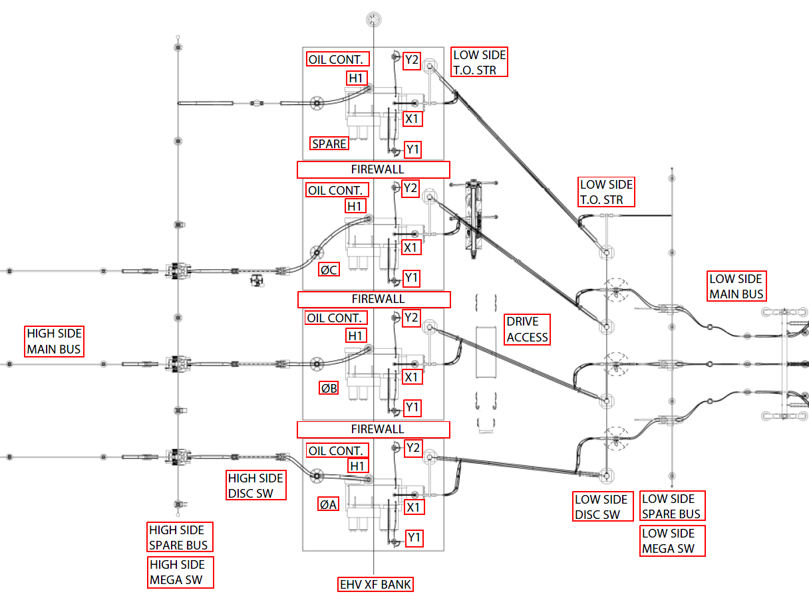
New Standard Physical Layout
Fire Mitigation implemented
P&C measures already incorporated
Notes:
Chris
This system also allows for two electrically identical side-by-side banks to share one spare.
The P&C measures are already incorporated, along with fire mitigation elements. These topics will be covered in more detail shortly.

Slide 7
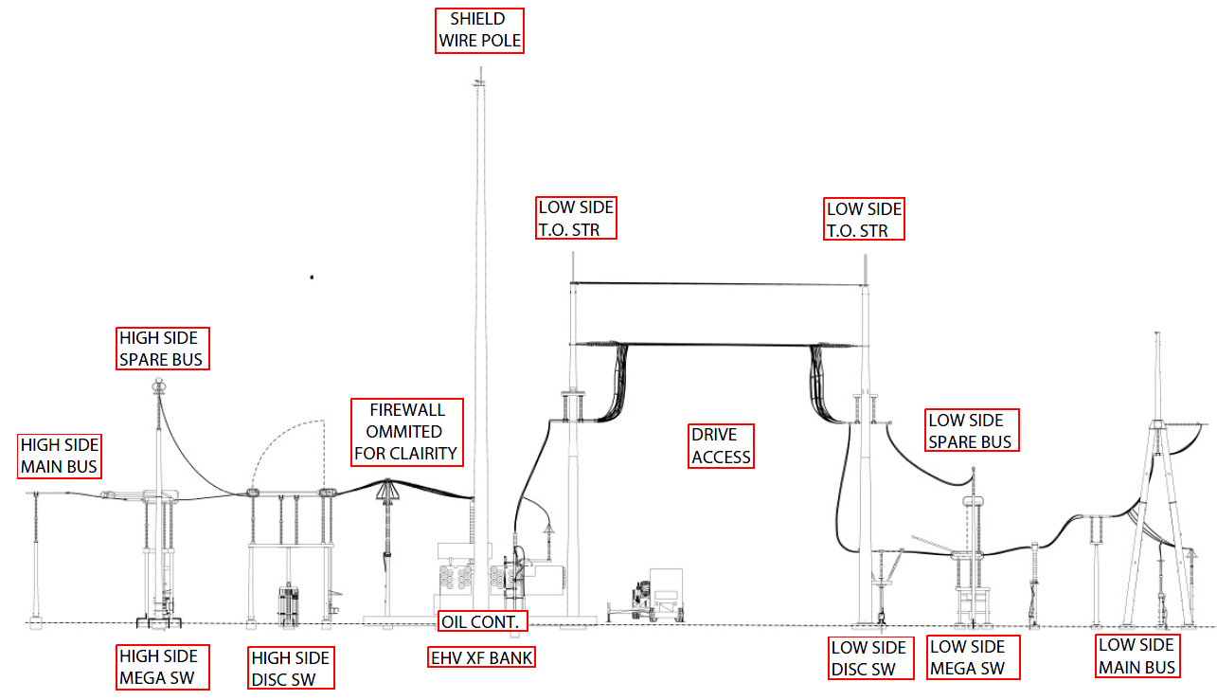
New Standard Physical Layout
Accessibility to Equipment
New!
New!
New!
New!
Notes:
Chris
This new layout also included necessary electrical and overhead clearances of the structures and bus work so that maintenance, repair, and removal of the de-energized unit can be done while the three remaining units of the bank remain energized.
The switchable spare design required the development of new electrical equipment and structures, most notably the phase-to-phase air gap MEGA switches and the take-off structures.

Slide 8
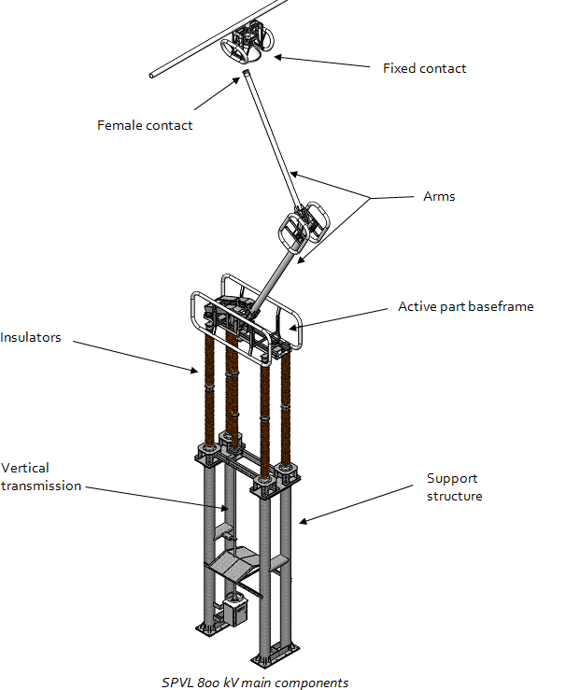
New MEGA Switch
Alstom Grid SPVL 800kV
Notes:
Chris
The MEGA switches were developed by Alstom Grid specifically for AEP’s layout and are the first-of-their-kind in the world. The switch is phase-to-phase, requiring the pole to be twice as long as the usual design of a phase-to-ground switch.

Slide 9
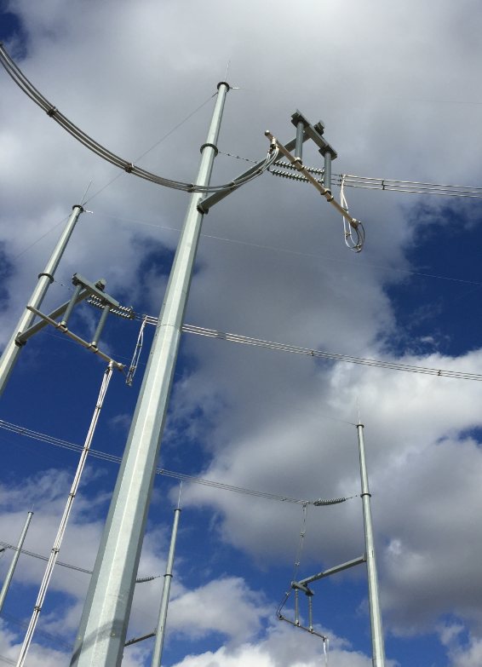
New Take-Off Structure
Notes:
Chris
Here is a photo of the newly developed Take-Off Structure. It was designed to allow for adequate overhead clearance over the drive aisle for continuous operation during construction or maintenance.

Slide 10
Cost
New Layout
Upfront cost of spare equipment
Old Layout
Transport
Reassemble
Test
Longer Outage on Grid
Notes:
Chris
Although the switchable spare layout requires the upfront cost of the spare equipment, it is estimated that the cost to tear down, move, transport, reassemble and test a new unit during an outage can total up to $1 million. Additionally, a shorter outage benefits operations and grid reliability immeasurably.
Olivia will now talk about the new Protection and Control Scheme that was incorporated.
< transition to Olivia >

Slide 11
Protection & Control Scheme
Past
Needed to rewire protection scheme when spare transformer was placed in service.
Required retesting of protection scheme.
This process could take up to 2 days to complete.
New Design
All wiring and testing is completed when the system is commissioned.
Relay reconfiguration can be completed in a matter of seconds.
Notes:
Olivia
In past protection designs for this application, when the spare transformer or shunt reactor needed to be placed in service, the CT circuits, tripping circuits, control circuits and alarm circuits would need to be modified to place the spare transformer into the correct phase position of the protection scheme. This would require modification of wiring and retesting of the protection scheme. This process could take up to two days to complete.
In the new design, all circuit wiring and relay testing for the spare is performed along with the entire bank during commissioning, eliminating the need for rewiring and relay testing when the spare transformer is needed to switch into service. This results in no field wiring during restoration, saving valuable time. With the application of modern microprocessor relays, the new protection scheme is reconfigured in a matter of seconds.

Slide 12
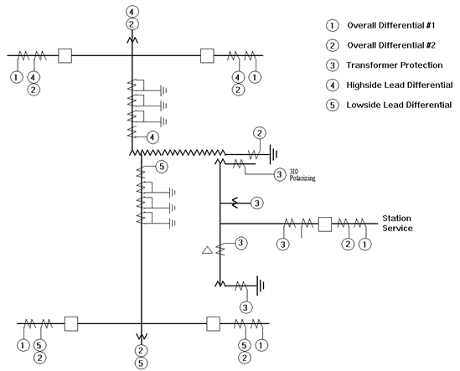
Protection & Control Scheme
Notes:
Olivia
Here is the one-line diagram of our protection scheme.
Highlighted are the two Overall Differentials, as well as the Highside and Lowside Lead Differentials.
The Overall Differential #2 relay includes Restricted Earth Fault protection. Since the transformers are single phase units, the neutral CT from each phase transformer and spare are connected in parallel.
The high-side and low-side lead differential relays provide the ability to determine fault location, that is, whether the fault is inside the transformer or outside the transformer.

Slide 13
Protection & Control Scheme
Both Overall Differentials do not need to be reconfigured when the spare is placed in service.
The High-side and Low-side Lead Differentials do need reconfiguration when the spare is placed in service.
Notes:
Olivia
< read slide >

Slide 14
Protection & Control Scheme
Transformer CT’s are inserted or removed from the lead differentials by using relay programmable logic.
Lead Differential Protection Reconfiguration effects the following:
Differential Protection
Sudden Pressure Tripping (Low-side only)
Phase Time Overcurrents (Low-side only)
SCADA Metering
Notes:
Olivia
Transformer CT’s are inserted or removed from the lead differentials by using relay programmable logic.
Both the high-side and low-side lead differential relay provides protection functions that include: Differential protection, sudden pressure tripping, phase time overcurrents, and transformer metering for SCADA.

Slide 15
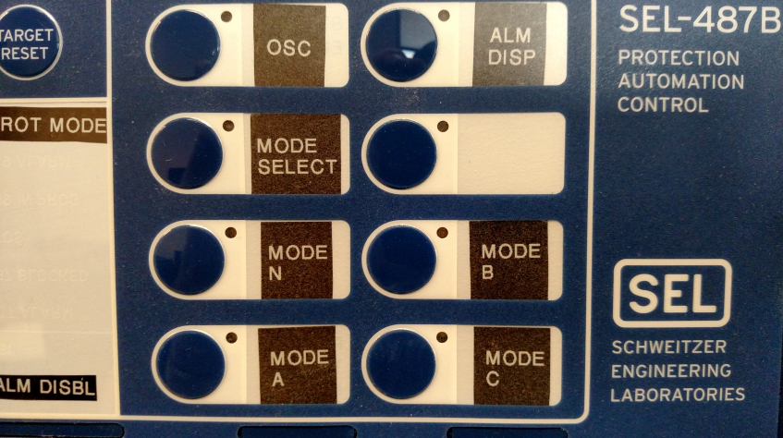
Protection & Control Scheme
Pushbuttons on the Lead Differentials allow the operator to quickly reconfigure the protection.
Spare not in Service
Spare inserted in Phase B
Spare inserted in Phase A
Spare inserted in Phase C
Notes:
Olivia
Reconfiguration of the protection scheme is accomplished by pressing pushbuttons on the front of the high-side and low-side lead differential relays. There are four protection modes: Mode N (Phase A, B and C in service); Mode A (spare-switched into Phase A); Mode B (spare-switched into Phase B); and Mode C (spare-switched into Phase C).

Slide 16
Protection & Control Scheme
IEC61850 GOOSE
High-side Lead Protection Mode
Low-side Lead Protection Mode
Transformer Switches
If any are out of agreement, an alarm is generated.
The alarm will clear once all relay Modes are in agreement with each other.
Notes:
Olivia
During the reconfiguration process, the high-side and low-side lead differential relays monitor each other’s protection mode. This is accomplished using IEC61850 GOOSE messaging. In addition, the protection mode of each relay is compared to the status of all the transformer switches used to reconfigure the bank. An alarm is generated when the relay protection modes or transformer switch statuses do not agree on the location of the spare transformer. Once all are in agreement, the alarm will clear.

Slide 17
Fire Mitigation
Fire walls
Protect adjacent high-risk equipment
Between every phase
Oil Containment Drainage
Suppress pool fire
Fire-Resistant Coating
Large structures in immediate proximity
Notes:
Olivia
Fire mitigation is a key component of reducing outage time. AEP’s choice for fire mitigation includes a combination of fire walls and an oil containment that allows oil to be drained to a remote location. The firewalls protect adjacent high-risk equipment, while the stone-lined containment and drainage is designed to suppress a high radiation energy pool fire.
The firewalls are installed between each phase. Consideration also is given to other nearby sensitive equipment. Large structures, such as deadend or take-off structures, that are located within the oil containment have a fire-resistant coating applied in order to avoid failure of the structures and cascading damage to nearby equipment. In addition, these large structures tend to have a longer procurement lead time, and would require outages of additional equipment if replacement was required; therefore their preservation reduces the risk of a longer restoration and outage.

Slide 18
Fire Mitigation
Oil Containment
Structural Containment
Standardized size for large comparable equipment
Dual Drain with filters and oil capture
Continuous drainage of water with ability to capture oil and minimal maintenance.
Notes:
Olivia
The oil containment design has been an iterative process. As newer technologies have been made available, we have sought to minimize installation costs and maintenance needs. The current design is in the pilot phase. It is comprised of a structural containment and a dual drain system with filters and oil capture. The above grade structural oil containment is sized for the full oil capacity of the largest version of the contained equipment, thereby eliminating changes to the containment in the event that a replacement unit is purchased from a different vendor.
The drain systems allow continuous drainage of water and the ability to retain oil in a catastrophic event. The only maintenance anticipated will be the occasional cleaning and replacement of filters.

Slide 19
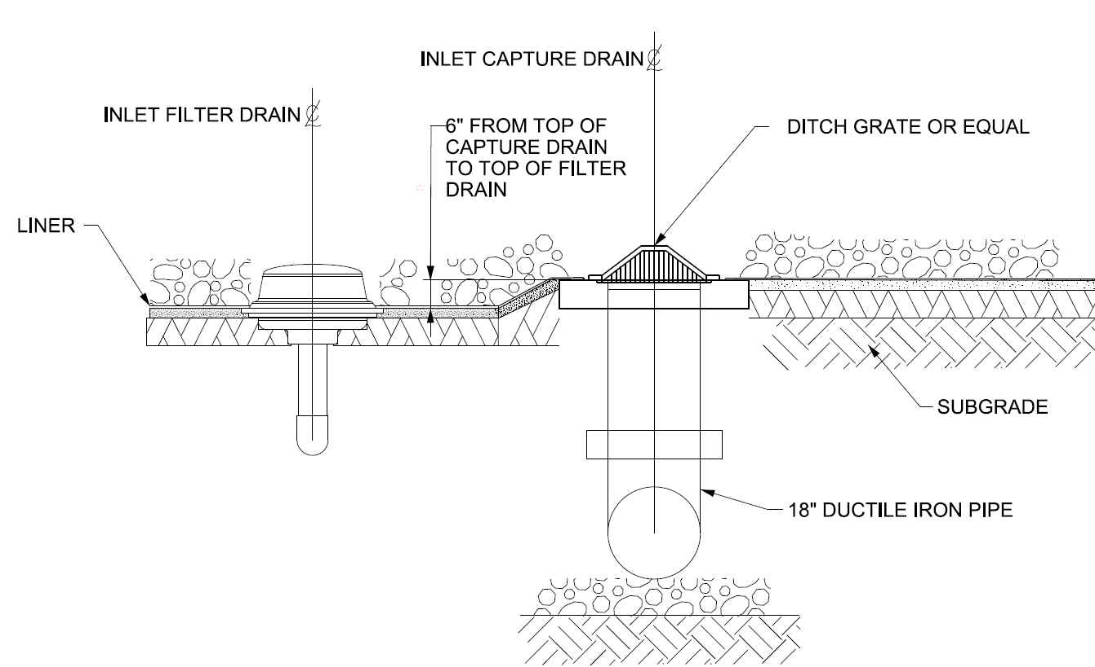
Fire Mitigation
Daylight
Oil Filter
Add’l Rain /Oil Spill
Capture Containment
Daylight
Oil Filter
Majority of Rain
Notes:
Olivia
< click >
The dual drain includes a lower-elevated drain intended for the majority of rain water to flow to daylight through an oleophillic polymer filter. This filter, essentially clogs up in the presence of oil, and then restricts all flow.
< click >
The upper drain leads to oil capture containment via ductile iron pipe. The oil capture containment daylights water and also has an oleophillic polymer filter or an oil detecting pump (depending on site drainage conditions).

Slide 20
Application
1st Piloted in 2012 for 765kV Transformer Bank
Expanded to Shunt Reactors
7 installations since 2012
11 more planned
2 Failures have confirmed the benefits
Notes:
Olivia
The first application of our switchable spare physical layout was piloted in 2012 for a 765kV transformer bank. After a successful installation, the design was applied to other voltage combinations and equipment such as shunt reactors. The switchable spare design has been successfully implemented for three transformer banks and four shunt reactor banks since 2012. It is also either under construction or planned for 11 additional 765kV transformer or shunt reactor banks.
AEP has since experienced two failures that successfully utilized this system. The outages were minimized, confirming the benefits of the new design.

Slide 21
Conclusion
Safety
Eliminate rushed construction in failure situation
Maintenance
In-service spare rotation
Grid Resiliency
Reduced outage time
Cost Savings
Logistical savings in moving remotely located spare
Notes:
Olivia
In conclusion, the time to restore 765kV service to as little as three hours, down from a range of three days to three months was achieved through a layout that involved a new switch design, a supporting protection scheme, and fire mitigation. Once the spare is energized, the removal and replacement of the failed unit can occur while the restored transformer or shunt reactor bank remains energized.
The following points summarize the value of the switchable spare design to AEP and why this layout is now the standard application to be utilized across our system.
< click > < click between bullets >
* Safety – Eliminates the exposure of field personnel to the potential hazards in a rushed construction situation.
* Maintenance – This layout provides for in-service spare rotation, keeping the transformers at their highest performance level since the spare arrangement can be energized routinely.
* Grid Resiliency – Reduced outage time removes burdens on the grid.
* Cost Savings – Cost to remove, transport, install, and commission a remotely located spare unit is estimated at up to $1 million per event, in the event of a failure. It has been determined that this logistical cost and risk to the grid outweigh the upfront installation and cost of the spare unit.

Slide 22
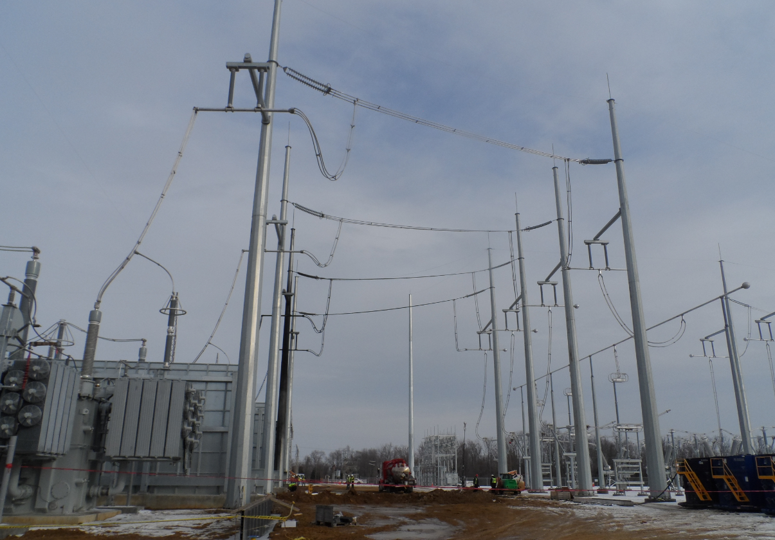
Thank You!
Notes:
Olivia
That concludes our presentation, thank you for your time!

