Slide 1
Rohit Sharma
Product Manager - Grid Connectivity
S&C Electric Company
Rohit.Sharma@sandc.com
Understanding Your Options
Methodology for Evaluation and Selection of Wireless Communication Systems for Smart Grid Applications

Slide 2
Network demands increase with advanced applications
AMI
Grid Automation: Rapid Self-Healing
Grid Network Control: Advanced Grid Applications
Network Demands
High Speed
Low Delay
High Availability
Grid Applications

Slide 3
Early Grid Applications
Network Demands
Demand Response
AMI
AMR
Metering
AMI Connectivity provides access to valuable data

Slide 4
Grid Application proliferation starts
Network Demands
Demand Response
DMS
AMI
OMS
Protection and Switching
SCADA
DNP3
AMR
SCADA
proprietary
Metering
Distribution Automation
An integrated AMI/OMS can improve recovery, but it is not Automation

Slide 5
Grid Application advancements
Network Demands
Enhanced
Coordination
Volt-Var
Demand Response
Rapid
Self-Healing
DMS
AMI
OMS
Protection and Switching
SCADA
DNP3
AMR
SCADA
proprietary
Metering
Distribution Automation
Grid Automation & Control
Shift from slow, centralized to expedient, intelligent control

Slide 6
Grid Application proliferation
IEC61850
Network Demands
Enhanced
Coordination
Volt-Var
Frequency
Regulation/ PMUs
Demand Response
Rapid
Self-Healing
DMS
OMS
Video Surveillance
AMI
Protection and Switching
SCADA
DNP3
Renewable
Control
AMR
SCADA
proprietary
Metering
Distribution Automation
Grid Automation & Control
Future applications to automate outage reduction “Grid Automation & Control”

Slide 7
Requirements considerations for Grid Communications
Requirement | Parameter
Bandwidth | Packet rate (pps)
 | Packet size
Quality of Service | Latency
 | Jitter
 | Packet Loss
 | Transaction delay
 | Traffic Priority
Network Management | Alarms logging
 | Statistics logging
 | Accounting
 | Privacy
 | Time Sync
Requirement | Parameter
Scalability | No. of devices
 | Packet size
 | Multicast
Availability | Uptime
 | Redundancy
 | Fault tolerance
Security | Authentication
 | Authorization
 | Confidentiality
 | Privacy
 | Integrity
 | Segmentation
 | Threat detection & mitigation

Slide 8
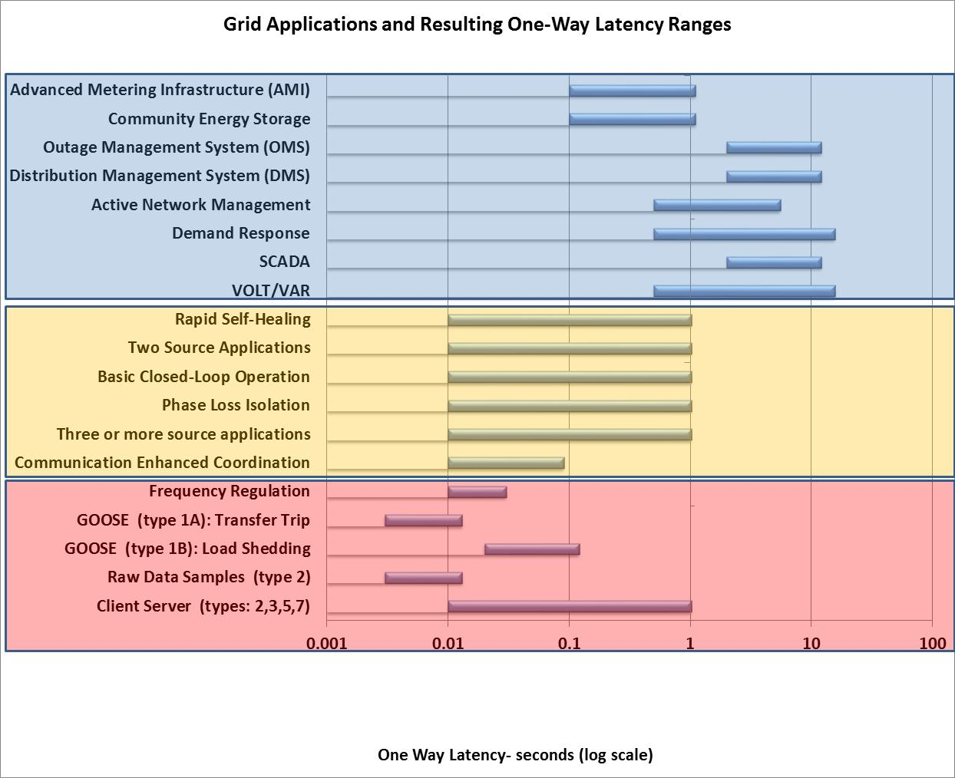
Latency requirements for grid applications
Latency tolerant
Latency sensitive
Latency intolerant
Rapid Self Healing: The difference between 10msec and 1000msec results in a difference of 3 to >30 seconds
CEC: Miss the latency here, and the opportunity has been missed

Slide 9
Grid Application demands
Application | Throughput (kbps) | Latency (msec) | Availability
AMI & Demand Response Legacy Distribution Automation (SCADA, Volt-Var, DMS, OMS) | <100 | 500 to 1000 | 2 to 3 NINES
Grid Automation & Control: Rapid Self-Healing | >100 | <100 | 4 to 5 NINES
Grid Network Control: Communication Enhanced Coordination | >300 | <80 | 5 NINES
Frequency Regulation IEC61850/GOOSE Type 1B (Load Shedding) | >500 | 10 to 50 | 5 to 6 NINES
IEC61850/GOOSE Type 1A (Transfer Trip) | >1000 | 3 to 10 | 6 NINES

Slide 10
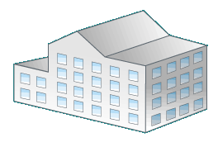
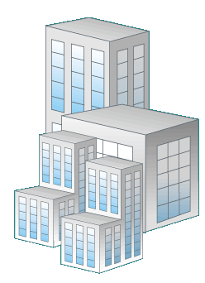
Public cellular networks (P2MP)
Master connects remote stations
Single point of failure
Coverage and overlap issues
Quality of Service burns channel capacity
PSBN build-out and cost
Cellular Type | Latency (msec) | Applications
3G | 80 - 150 | Metering/Latency Tolerant Apps Legacy “DA” Slow Self Healing (limited range)
WiMAX | 50 - 110
4G LTE | 40 - 100 | Moderate Speed Self Healing
Public Safety Broadband Network/Private 700 LTE | 40 – 100

Slide 11
Private mesh radio networks
No single failure point
Easily extensible
Vast Performance Differences
Mesh Type | Latency (msec) | Peak Throughput (kbps) | Typical Spectrum | Applications
Legacy AMI | 100 - 700 | ~100/ node | 900MHz ISM | Metering/Latency Tolerant Apps Legacy “DA” Slow Self Healing (limited range)
Distribution Automation | 25 - 350 | ~300 | 900MHz ISM, 900 MHz Licensed
Grid Automation & Control Layer3 | 10 - 70 | ~650 | 900MHz ISM, 900 MHz Licensed | Rapid Self Healing Communication Enhanced Coordination
Grid Automation & Control Layer2 | 1 - 7 | > 6000 | 2.4GHz 4.9GHz 5.xGHz | Backhaul IEC61850 Type 1B/1A Future Apps (Video)
Notes:
Talk about evolution of 802.154g

Slide 12
Other aspects in choosing Communication Systems
Network ownership
Build private network or lease public network
Cost
CAPEX (high for private comm sys, low for cellular or satellite)
OPEX (low for private comm sys, high for cellular or satellite)
Financing and ROI
Coverage
Size of area to cover – huge, large, medium, or small
Urban, sub-urban, and rural

Slide 13
Other aspects in choosing Communication Systems
Regional spectrum availability
Interference issues
Mitigation using Frequency Hopping Spread Spectrum
Use of licensed frequencies
Lifetime and Innovation
Integration of legacy deployed systems with new technology

Slide 14
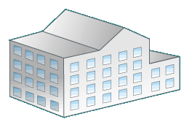
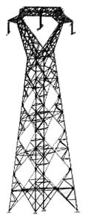
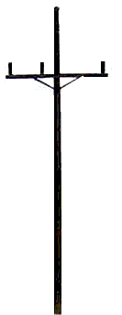
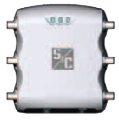
Layered Communications approach
4.9 GHz
5.8 GHz
5.4 GHz
2.4 GHz
WAN
AMI-WAN
Grid Automation &
Control WAN
3G/4G
900 MHz ISM & Licensed
Collector
3G/4G
PLC
3G/4G
Notes:
Single purpose networks not viable
Diverse use cases
No single network is sufficient
Separation into multiple, layered networks
specialized, efficient solutions
enables smooth migrations

Slide 15
Conclusion
Fast, reliable, and secure communication networks are must have for success of Smart Grid
No single communications technology will fit all needs
A layered, purpose built network approach is most efficient , cost responsible, and extensible
Grid Applications are evolving and becoming more demanding on the networks that support them
Require lower latency and higher bandwidth as Grid Applications and associated Grid Automation & Control evolves

Slide 16
Questions?
16

