Slide 1
The Nanogrid Collective:
Integrating Thousands of Customers Into System Operations and Markets

Slide 2
Trends
Domestic demand response
Rapidly expanding rooftop solar
Interest in smart home
Internet of things in the home
Smart thermostats
Internet connected devices
Decreasing cost of storage
Electric vehicles

Slide 3
What’s the problem?
Avoiding massive response
Timely demand response
Frequency and voltage control
Communication speed and delays
Record keeping
Security

Slide 4
What is the nanogrid
Not smart grid or micro grid—these are much bigger
Control of multiple devices in residences and small businesses
Two main elements
Master controller in residences
Collective providers
Google/Nest
Carbon track
Others

Slide 5
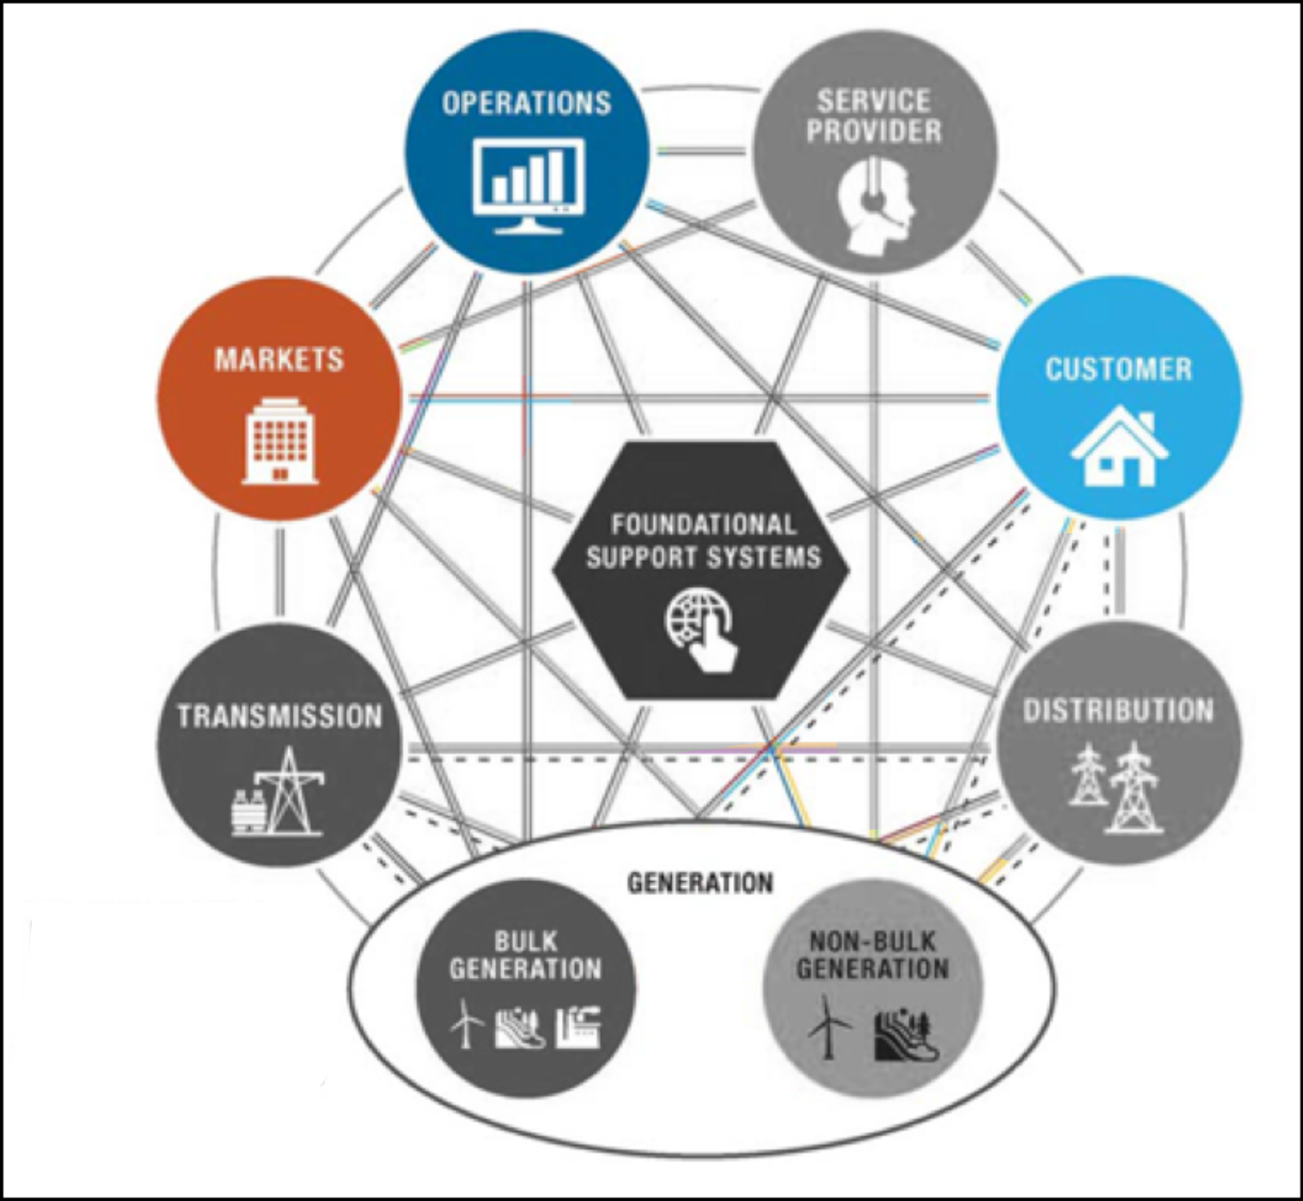
nist smart-grid domains
Collective provider/operator
Master controller
Customer storage

Slide 6
Nanogrid master controller
Monitors all controlled devices
Use predictive techniques to anticipate usage
Record actual use (can be audited)
Response when controlled—for markets
All use—for customer information
Allow customer programming
Respond to system costs and conditions
Provides some randomness
Allow secure vendor software updates

Slide 7
The collective providers
Private/competitive marketplace
Communicate with market and system operators
Communicate with master controllers
Performs record-keeping (can be audited)
Collects and distributes funds
Stores customer usage
Offers various customer pricing ‘plans’ and options

Slide 8
Benefits
Competitive multiple providers (not utility)
Use private capital (and risk)
Smart-phone/internet oriented--the ‘cool’ factor
Customer acceptance
Easy interface
Insulates customers from details (they mostly don’t care)
Flexible—can update master controllers as needed
Track and control individual customers
Locations are known

Slide 9
Solutions
Avoiding massive response—introduce randomness
Timely demand response—local control
Frequency and voltage control—local control
Communication speed and delays
Pricing can be slow (minutes)
Frequency & voltage instantaneous
Record keeping—handled by collective providers
Security—remote software update

Slide 10
Remaining obstacles
Security must be part of internet things
Common standards are needed
Great software interfaces
Replacing the fleet of appliances
What is the business model
Markets are needed for it to work fully

Slide 11
Thank you
jeff@pjp-consulting.com
+1 703 401 7079

